Slide 1

Part 2 of Slides

Slide 3
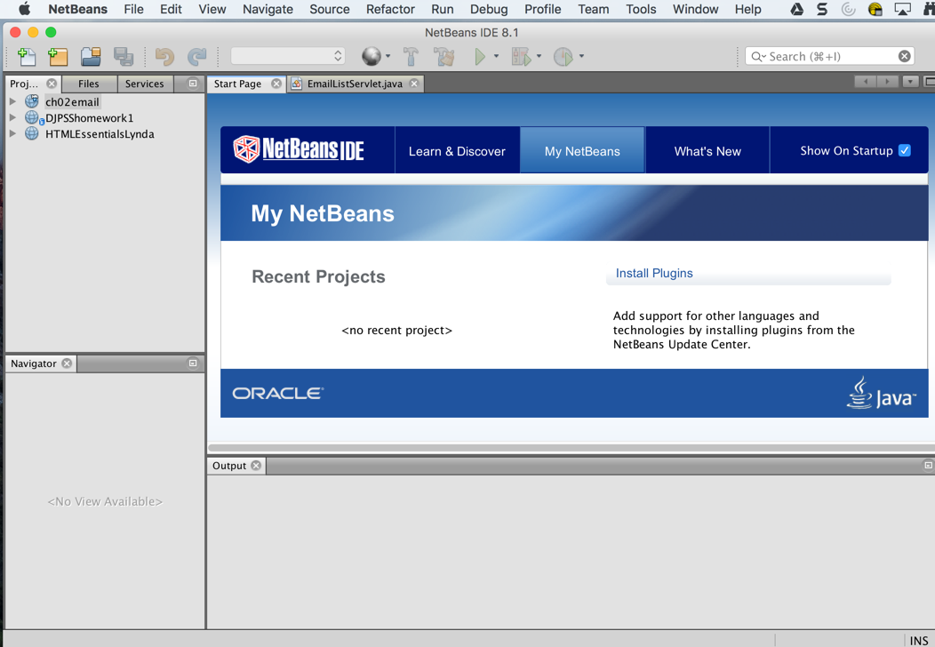

Slide 4
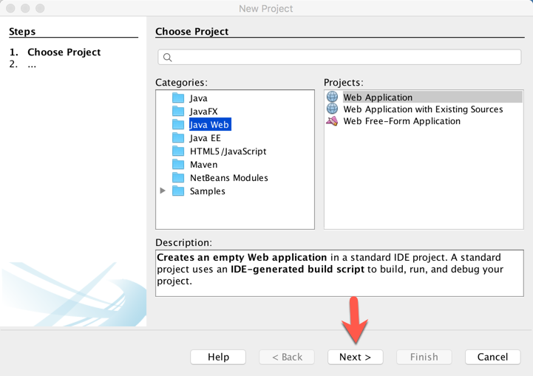

Slide 5
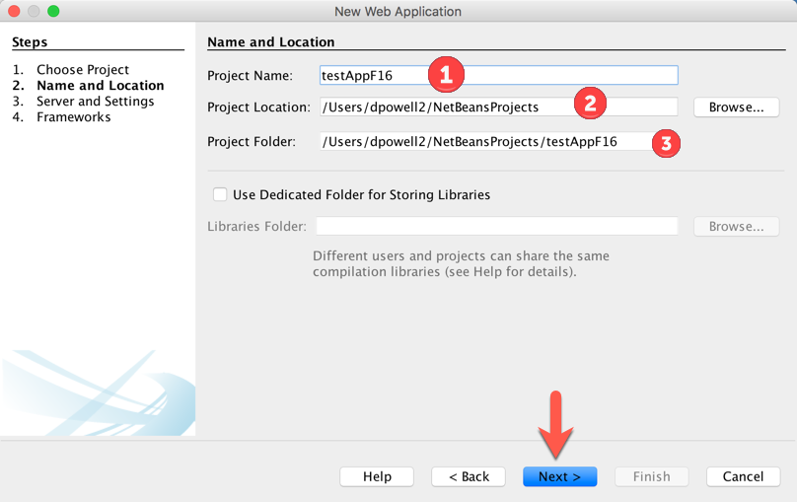

Slide 6
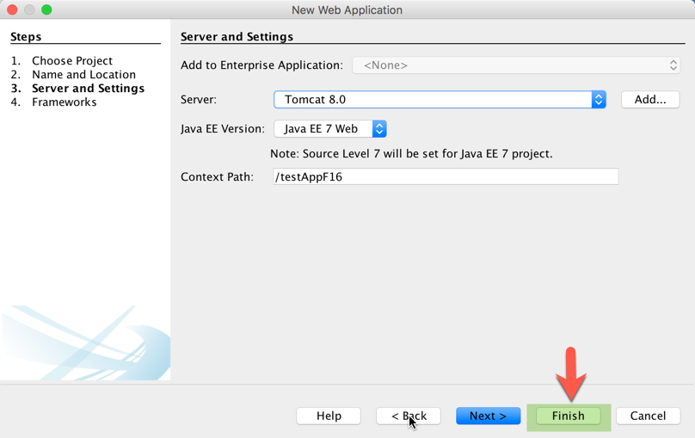

Slide 7
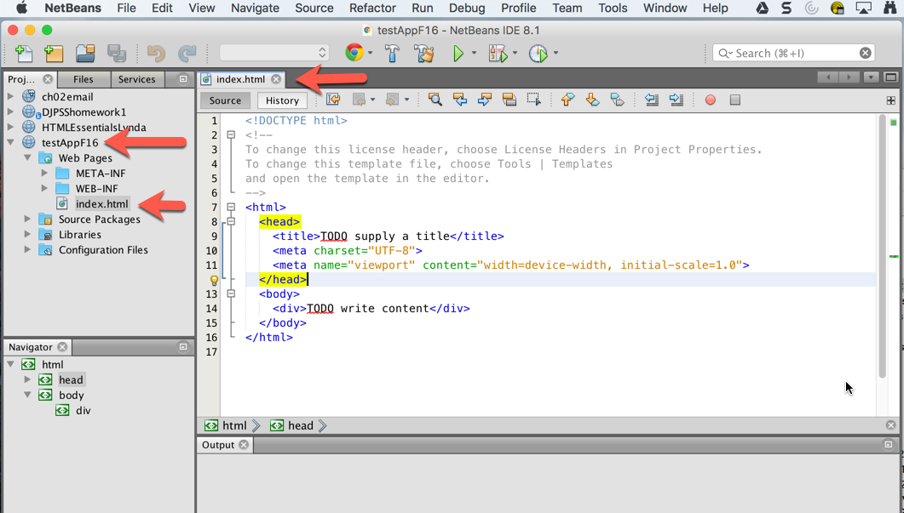

Slide 9
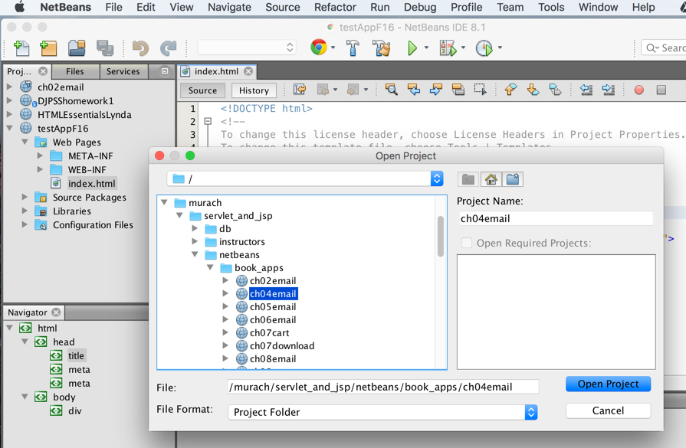

Slide 11
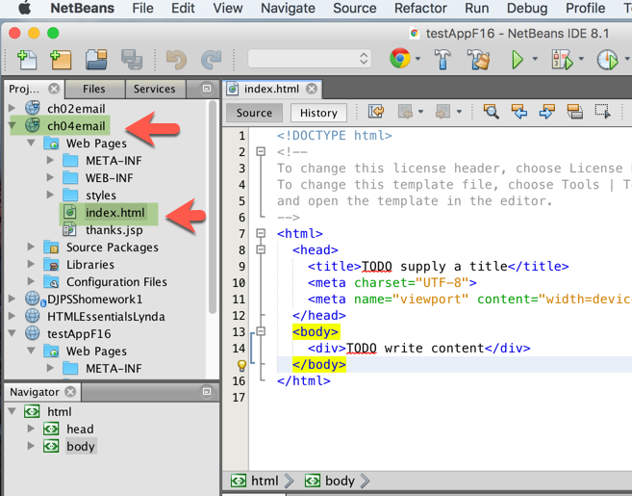
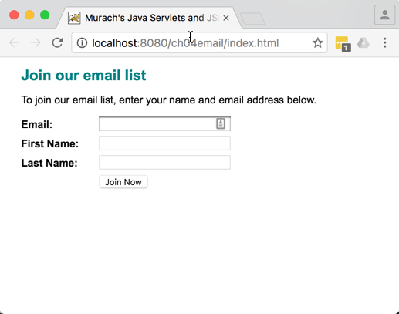

Slide 14
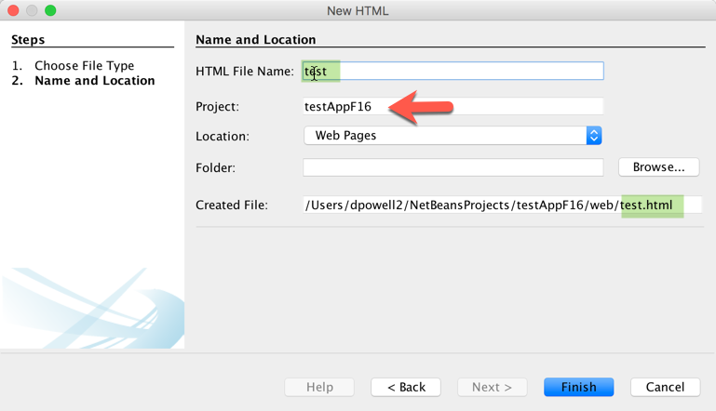

Slide 15
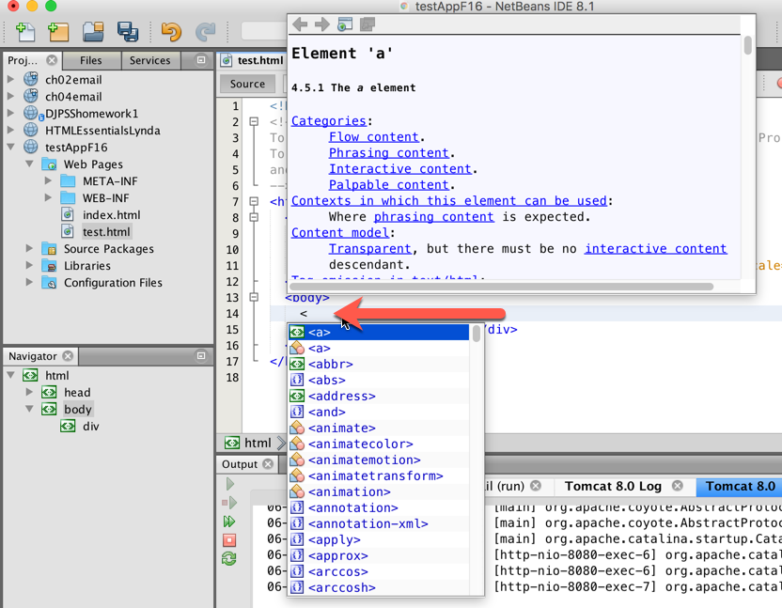

Slide 17
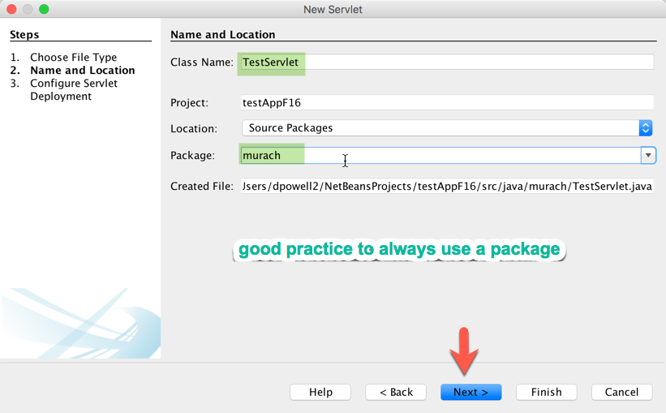

Slide 18
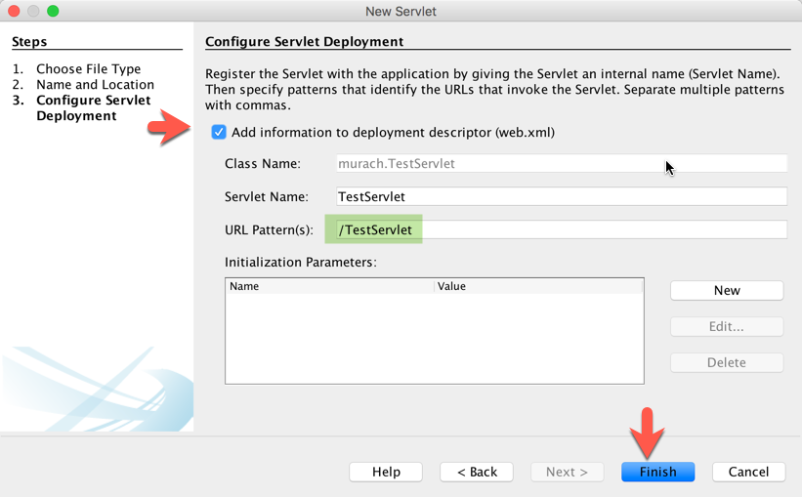
The second servlet dialog box

Slide 19
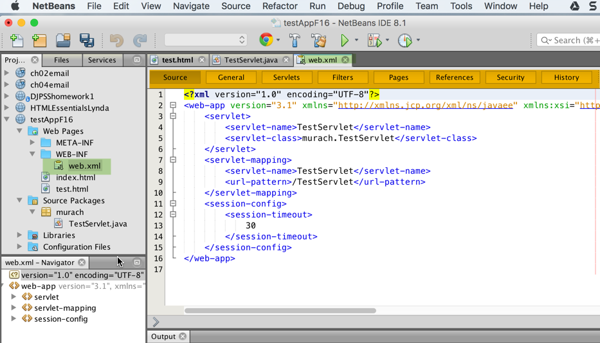

Slide 20
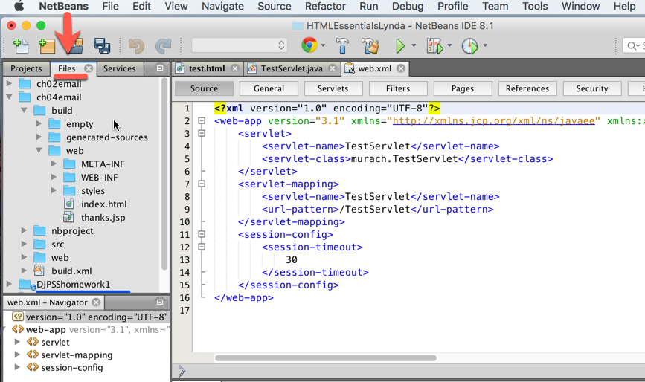

Slide 22


Slide 23
Lets Add Our Chapter 1 of Lynda Exercise Files to testAppF16

Slide 24
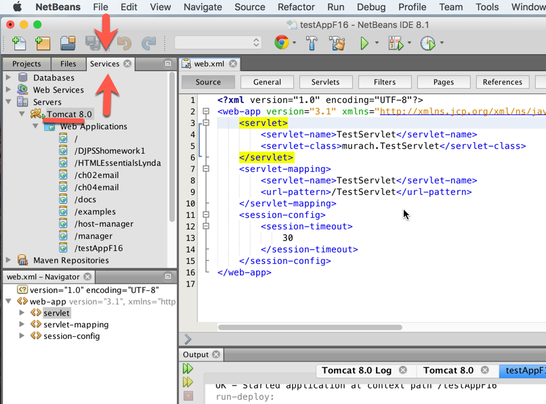

Slide 26
To Do – Time permitting
Create a GitHub Repository on GitHub
Bring up Terminal window on Mac or Git Bash window on windows
cd to location of netbeans project for testAppF16
git init
Git remote add origin <github address>
Git push origin master
Run html page on GitHub
If time validate web page

